Slide 1
Univariate, Bivariate &Multivariate Analysis
Team 6
Anuvarsha
Satya
Santhi
Supriya

Slide 2
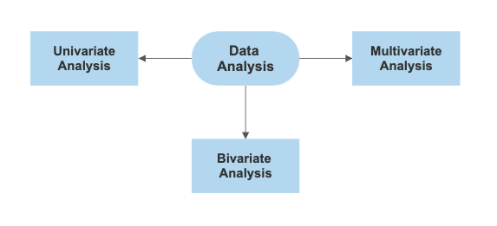

Slide 3
Univariate Analysis: Uni means one and variate means variable.
Univariate analysis is the most fundamental type of statistical data analysis technique.
The data in this case only has one variable and does not have to deal with a cause-and-effect relationship.
For example, the analysis could look at a variable such as "age," "height," or "weight."
It is possible for two kinds of variables- Categorical and Numerical.
Graphical Representation in Univariate Analysis:
Histograms
Bar Charts
Box Plots

Slide 4
Bivariate analysis The bivariate analysis involves the analysis of exactly two variables.
Bivariate analysis is a statistical method examining how two different things are related.
Bivariate analysis can be defined as the analysis of bivariate data. It is one of the simplest forms of statistical analysis, which is used to find out if there is a relationship between two sets of values.
It is a helpful technique for determining how two variables are connected and finding trends and patterns in the data. In statistical analysis, distinguishing between categorical data and numerical data is essential, as categorical data involves distinct categories or labels, while numerical data consists of measurable quantities.
Types of Bivariate Analysis:
Scatterplots
Correlation
Regression
Chi-square Test
T-test
ANOVA (Analysis of Variance)

Slide 5
Multivariate Analysis: The multivariate analysis involves the analysis of more than two variables.
Multivariate analysis refers to examining multiple variables simultaneously to understand relationships and how they jointly affect the target variable.
Various features like age , education, workclass , occupation and hours_per_week contribute to this prediction.
Multivariate analysis helps identify how these features interact and influence the target.
Importance of Multivariate Analysis
Handles Complex Data
Improves Predictive Power

Slide 6
Multivariate Analysis(contd): The multivariate analysis involves the analysis of more than two variables.
Identifies Relationships and Interactions
Dimensionality Reduction
Efficient Decision-Making
Choosing the right Multivariate Technique
Based on the objective of the analysis, We can select appropriate technique
Prediction: Use regression techniques (linear regression, logistic regression, etc.).
Clustering: Use k-means clustering or hierarchical clustering.
Dimensionality reduction: Use PCA or factor analysis.

Slide 7
Multivariate Analysis(Contd): The multivariate analysis involves the analysis of more than two variables.
Identifies Relationships and Interactions
Dimensionality Reduction
Efficient Decision-Making
Model Building
Split the data into training and test sets.
Build the model based on the chosen technique (e.g., multiple linear regression, PCA).
Fit the model to the training data and make predictions.

Slide 8
References:
Univariate Statistics and Examples
EDA Techniques Uni, Bi, Multivariates.
Deep AI Univariate analysis
Bivariate analysis
Multivariate analysis and Examples
Multivariate analysis Best practices blog

